Slide 1
ELECTRICAL ELEMENTS
ACTIVE ELEMENTS
PASSIVE ELEMENTS
INDEPENDENT
SOURCES
DEPENDENT
SOURCES
C
R
L
CCCS
CURRENT
SOURCES
VOLTAGE
SOURCES
CCVS
VCCS
IDEAL
CURRENT
SOURCE
PRATICAL
CURRENT
SOUCRE
IDEAL
VOLTAGE
SOURCE
PRATICAL
VOLTAGE
SOURCE
VCVS

Slide 2
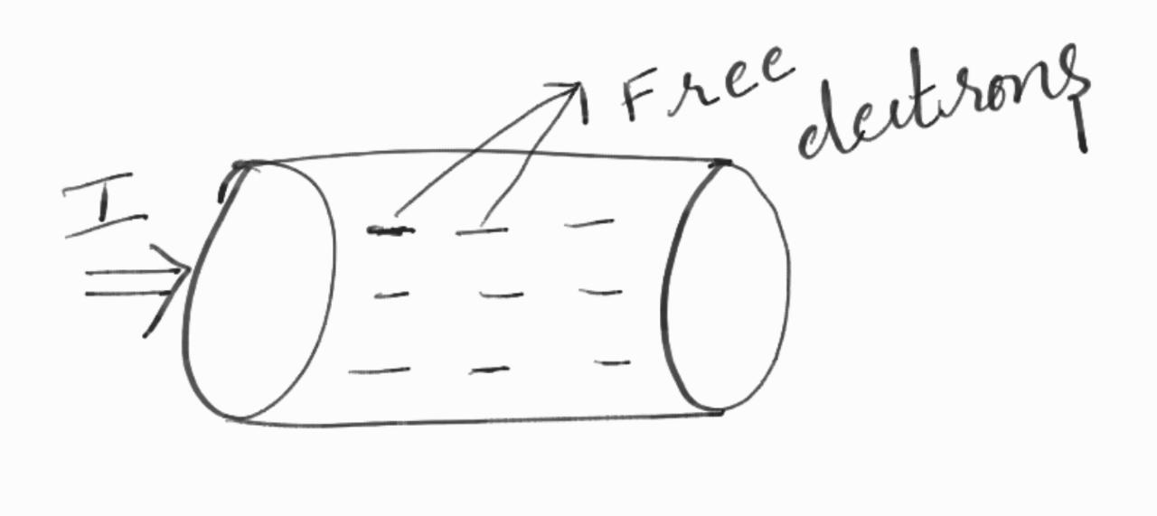
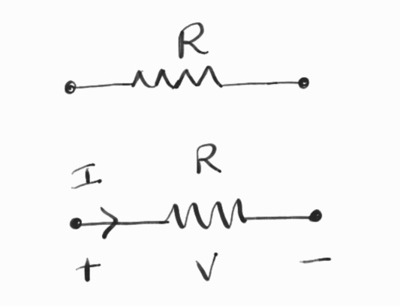
Resistance:
When a current flow in a conducting material, the free electrons move through the material and collide with other atoms. These collisions cause the electrons to lose some of their energy. This loss of energy per unit charge is the drop in potential across the material.
The amount of energy lost by the electrons is related to the physical property of the material. These collisions restrict the movement of electrons. The property of the material to restrict the flow of electrons is called resistance, denoted by R.
The unit of resistance is OHMS (Ω).

Slide 3
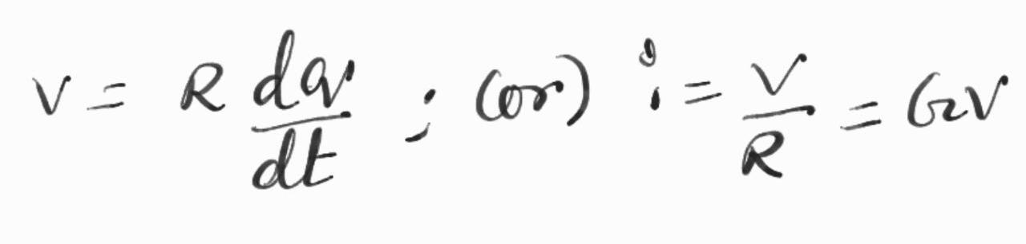
According to OHM’s law, the current is directly proportional to the voltage and inversely proportional to the total resistance of a circuit, i.e.,
I = V/R (or) i = v/R
we can write the above equation in terms of charge as follows:
where G is the conductance of a conductor. Units are mho(℧)

Slide 4
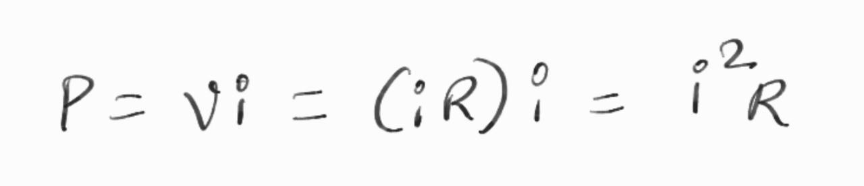
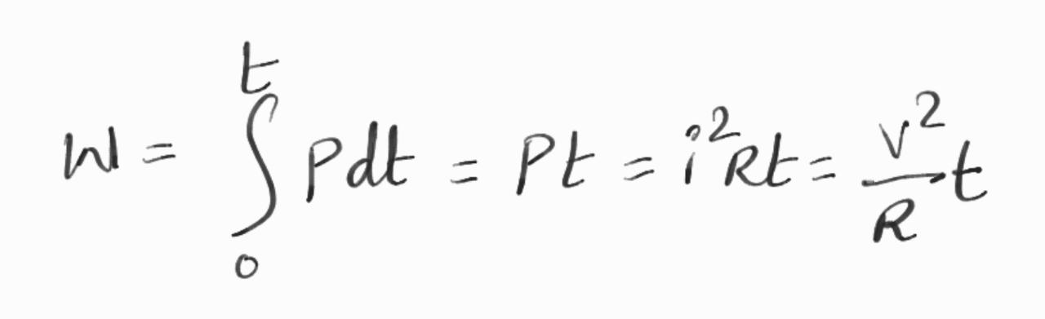
When current flows through any resistive material, heat is generated by the Collisions of electrons with other atomic particles. The power absorbed by the resistor is converted to heat.
The power absorbed by the resistor is given by
where I is the current in the resistor in amps and V is the voltage across the resistor in volts.
Energy lost in a resistor in time t is given by

